Slide 1

Exploratory Data Analysis on Engineering Graduates Employment Outcomes
Presented by: Kandukuri Jaswanth

Slide 2

Introduction
The AMCAT (Aspiring Minds Computer Adaptive Test) is a widely used assessment for evaluating candidates’ skills across various domains, including aptitude, logical reasoning, programming, and domain-specific knowledge. This project analyzes AMCAT-related data to uncover key insights, trends, and patterns that can help students and professionals improve their performance.
Using Python and data analysis techniques, this study explores the dataset, processes information, and visualizes important aspects such as score distributions, skill correlations, and candidate strengths. The goal is to provide a data-driven understanding of AMCAT results, highlighting areas for improvement and effective preparation strategies.
By leveraging libraries like Pandas, Matplotlib, and Seaborn, this analysis uncovers valuable insights that can assist job seekers in optimizing their preparation. The findings can also help recruiters and educators refine their evaluation methods, ensuring a better match between candidates and industry requirements.

Slide 3
Objectives
The primary objective of this project is to analyze AMCAT (Aspiring Minds Computer Adaptive Test) data to gain meaningful insights into candidates' performance across various skill domains. Key objectives include:
Evaluating score distributions to identify performance trends.
Analyzing correlations between different skill areas to understand candidate strengths.
Identifying factors influencing high and low scores to improve preparation strategies.
Utilizing data visualization techniques for clear and effective analysis.
Providing data-driven recommendations for candidates, recruiters, and educators.
This study aims to enhance AMCAT preparation strategies and support better recruitment decisions through data-driven insights.

Slide 4
Data and Methodology
This study utilizes AMCAT (Aspiring Minds Computer Adaptive Test) data to analyze candidates' performance across multiple skill domains. The dataset includes key attributes such as aptitude scores, logical reasoning, technical skills, and overall performance metrics.
The methodology involves:
Data Collection: Extracting and cleaning the dataset for accuracy.
Exploratory Data Analysis (EDA): Identifying trends, distributions, and correlations.
Visualization: Using Matplotlib and Seaborn for graphical representation.
Statistical Analysis: Evaluating key insights to enhance preparation strategies.
This approach ensures a structured and data-driven evaluation, providing actionable insights for candidates, educators, and recruiters.

Slide 5
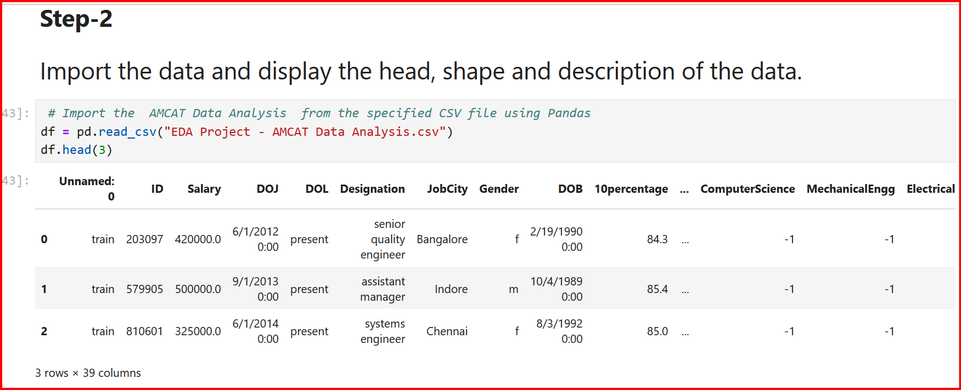
Understanding data
This displays the first five rows of the DataFrame.

Slide 6
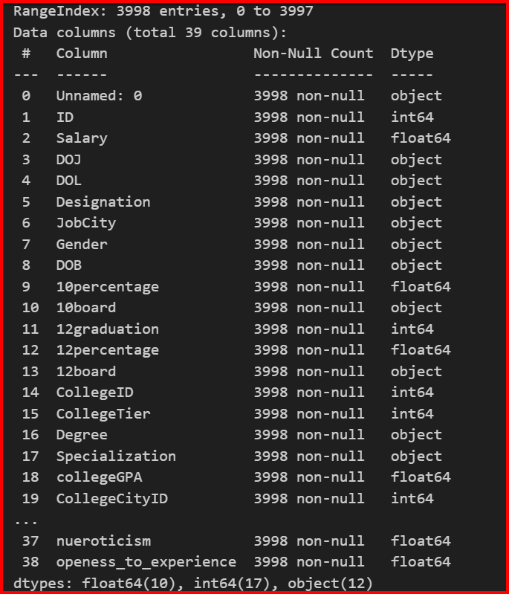
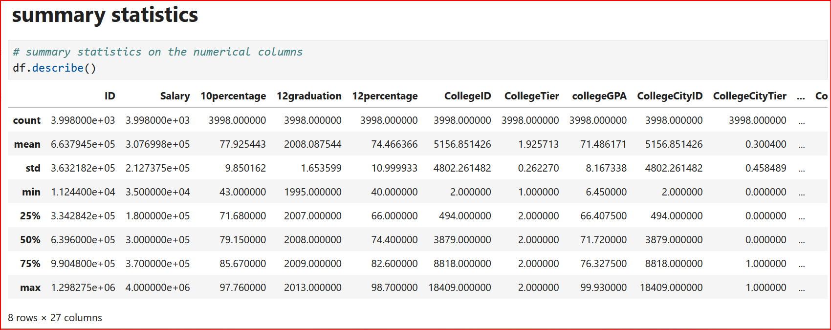
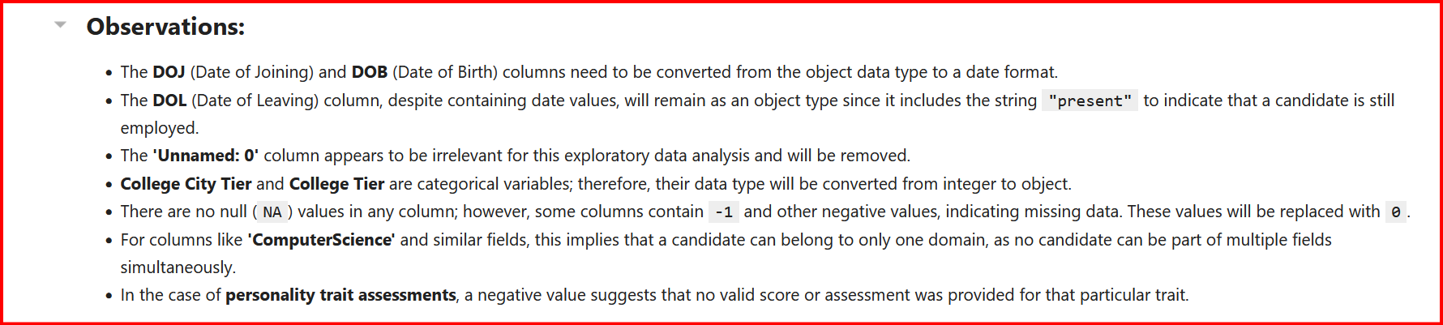
Understanding data

Slide 7
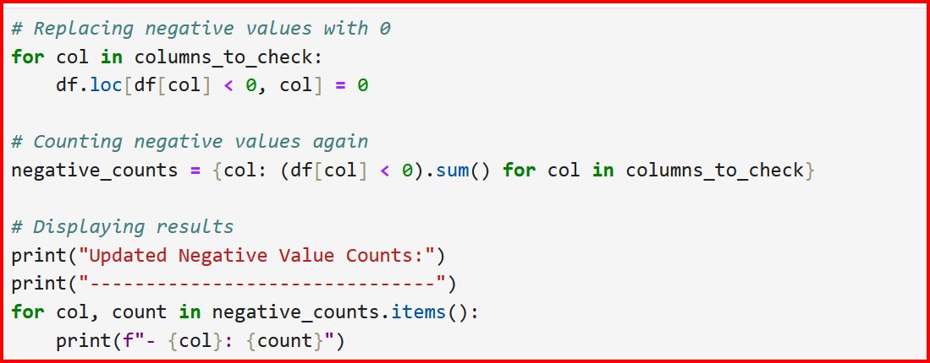
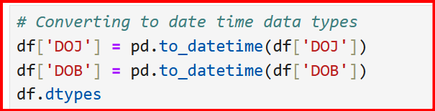
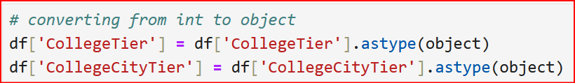
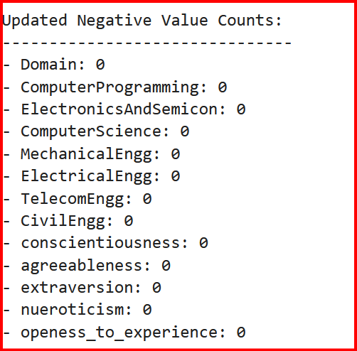
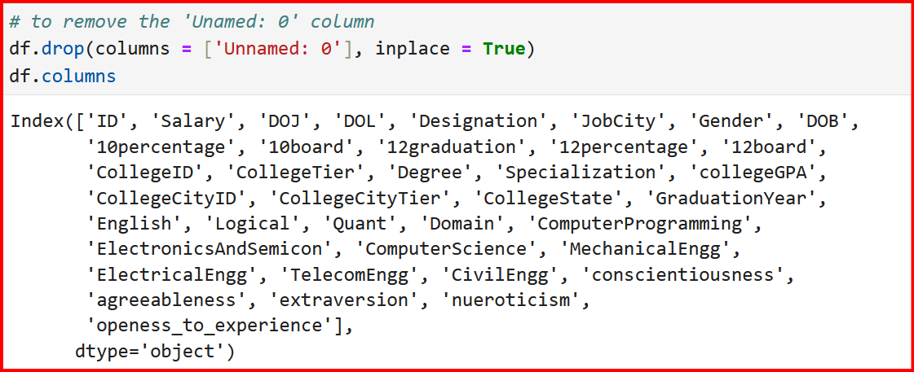
Data Transformation
Process for Data
Cleaning And
Transformation

Slide 8
Analysis and Insights
The analysis of AMCAT data reveals key trends in candidates' performance across various skill domains. Score distributions indicate common strengths and weaknesses, helping to identify areas requiring improvement. Correlation analysis between aptitude, reasoning, and technical skills highlights how different competencies impact overall scores.
Visualizations using Matplotlib and Seaborn provide insights into high-scoring candidates' characteristics and factors contributing to lower performance. Trends in section-wise difficulty levels offer valuable guidance for targeted preparation.
These insights assist students in optimizing their study strategies, recruiters in refining evaluation criteria, and educators in designing more effective training programs.

Slide 9
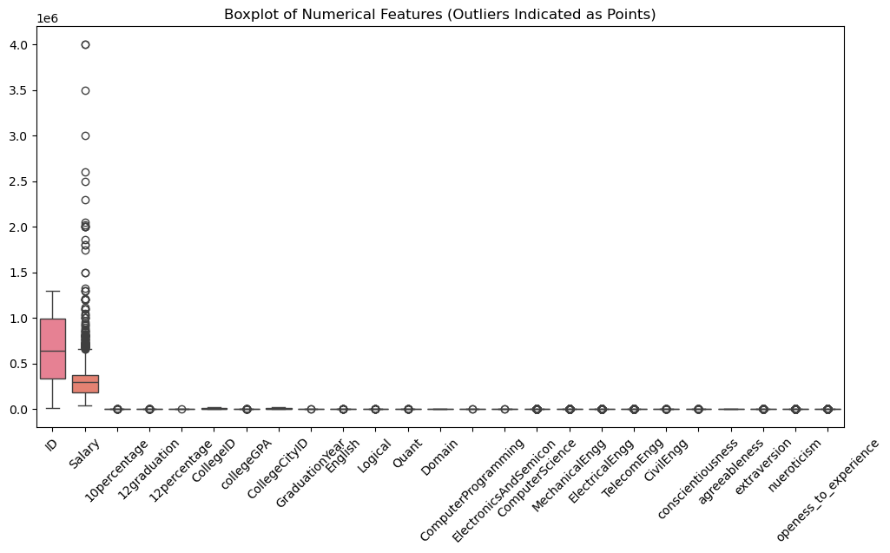
Univariate Analysis
The outliers using the Interquartile Range (IQR) method by selecting numerical columns and calculating Q1, Q3, and IQR. It identifies outliers beyond defined bounds and visualizes them with Seaborn boxplots, ensuring effective data cleaning and improving model accuracy.

Slide 10
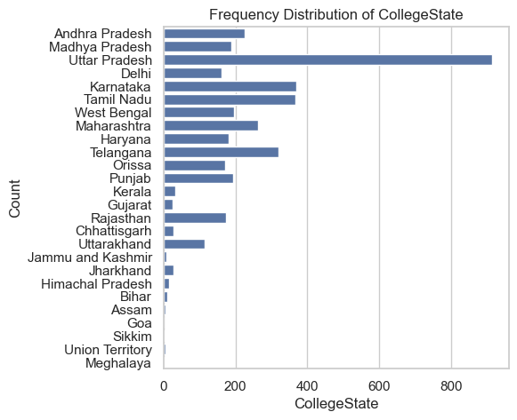
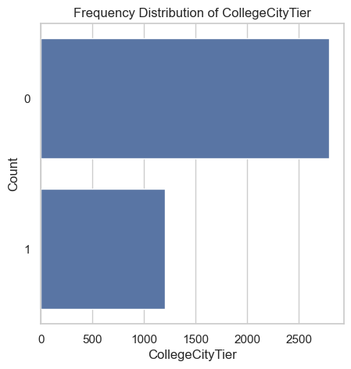
Univariate Analysis
The majority of candidates are from Tier 0 cities, while a smaller proportion belongs to Tier 1 cities, highlighting urban education dominance.
Uttar Pradesh hosts top engineering colleges with most candidates, while Delhi, Telangana, and Tamil Nadu excel in strong technical education systems.

Slide 11
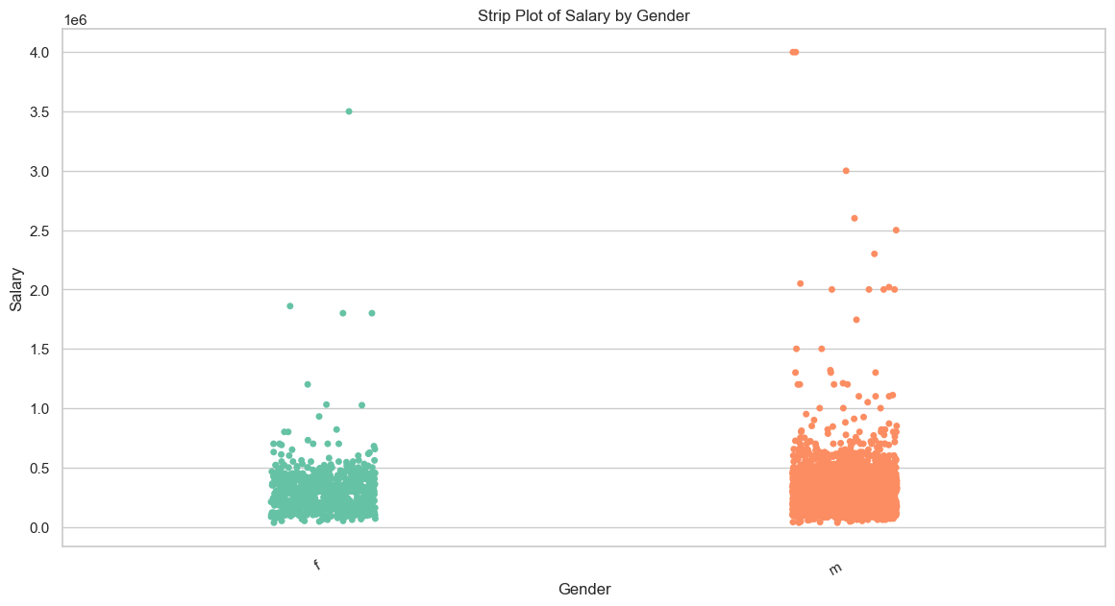
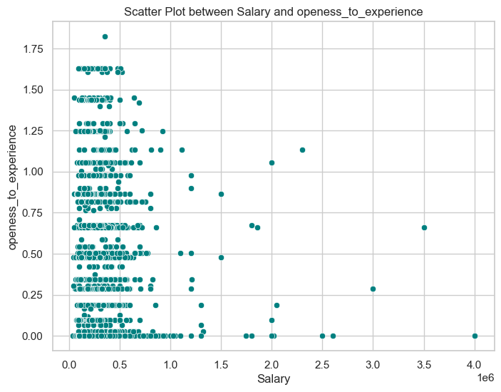
Bivariate Analysis
.
The code processes salary data by gender using a strip plot, visualizing distribution and outliers. It loads data, maps gender categories, and plots salaries. The highest earner appears in the male category.
The scatter plot illustrates the relationship between
salary and openness to experience. Higher salaries show varied openness, while lower salaries have concentrated openness levels, indicating potential correlations in career adaptability and compensation trends

Slide 12
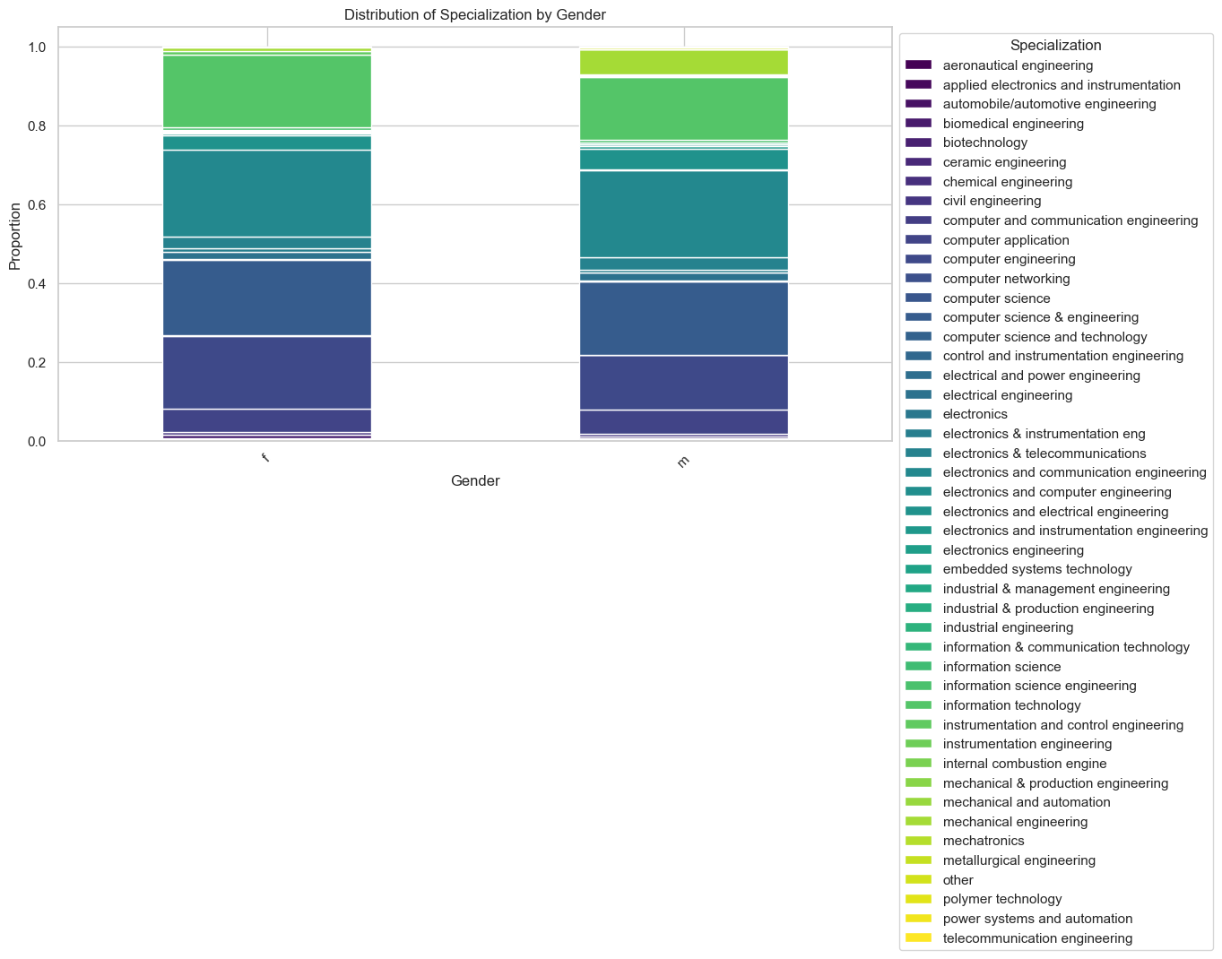
Times of India article dated Jan 18, 2019 states that “After doing your Computer Science Engineering if you take up jobs as a Programming Analyst, Software Engineer, Hardware Engineer and Associate Engineer you can earn up to 2.5-3 lakhs as a fresh graduate.” Test this claim with the data given to you.# Is there a relationship between gender and specialization? (i.e. Does the preference of Specialisation depend on the Gender?)
In the graph above, Computer Science and Engineering emerges as the most prevalent specialization among both males and females. Ceramic Engineering appears to be the least common, while Electronics and Communication Engineering represents the median specialization in terms of distribution

Slide 13
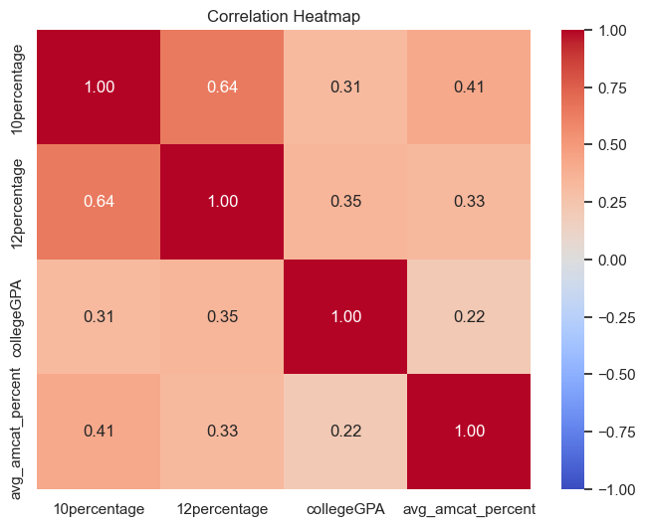
Is there a correlation between college GPA and AMCAT scores?
The heatmap illustrates the correlations among various academic performance metrics. The highest correlation is 1.00 (self-correlation), while the strongest meaningful correlation, 0.64, exists between the 10th percentage and 12th percentage, reflecting a significant relationship between these scores.

Slide 14
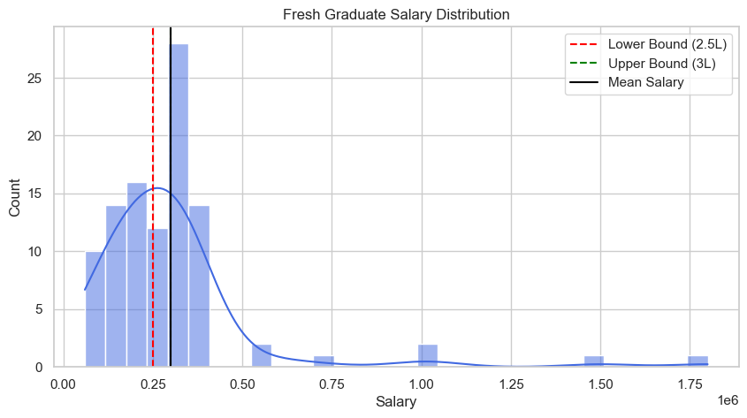
Is fresh graduate salary distribution significantly different from the expected range?
The histogram visualizes the salary distribution of fresh graduates. The lower bound is 2.5L (red dashed line), the upper bound is 3L (green dashed line), and the mean salary is indicated by the black line. The highest salary in the dataset appears beyond 1.75M. The average salary (ASL) can be estimated from the distribution around the mean salary. Let me know if you need a precise calculation!

Slide 15
Conclusion
The analysis in EDA Project - AMCAT Data Analysis provides a comprehensive exploration of employment outcomes for engineering graduates using the Aspiring Minds Employment Outcome 2015 (AMEO) dataset. Through exploratory data analysis (EDA), this study examines key factors such as salary distribution, job roles, and correlations between skills and employment outcomes.
By employing statistical tests and data visualizations such as t-tests, Chi-square tests, histograms, box plots, and scatter plots, the research uncovers critical trends in salary variations, gender-based specialization, and skill impact on job placement. The findings emphasize key employability patterns, enabling students to refine their preparation strategies, educators to enhance training methodologies, and recruiters to make data-driven hiring decisions.
This study contributes valuable insights into the engineering job market, offering a data-driven perspective on employment trends, skill demand, and career opportunities. The results help stakeholders navigate the evolving job landscape with informed strategies and better decision-making.

